Slide 1
Document Type Definition (DTD)
Define the legal building blocks of an XML document.

Slide 2
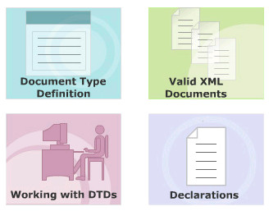
Module Introduction
Document Type Definition
Working with DTD
Valid XML Documents
Declarations

Slide 3
#1 - Document Type Definition (DTD)
DTD document is a non XML document made up of element, attribute and entity declarations.
A DTD document defines;
  The legal building blocks of an XML document.
  The document structure with a list of legal elements and attributes,
  The way elements relate to one another within the document’s tree structure
A DTD can be declared:
  Inline inside an XML document
  External reference.

Slide 4
Why Use a DTD?
DTDs are used by XML to provide an application independent way of sharing data.
Helps XML parsers to validate the XML document.
Helps authors to set default values for element attributes.
Common DTD can be used to interchange data between independent groups of people.
Application use DTD to verify
  Data enter XML document is valid.
  Data receives from the outside world is valid.
You can also use a DTD to verify your own data.

Slide 5
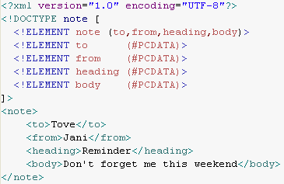
Example of Internal DTD Declaration
If the DTD is declared inside the XML file, it should be wrapped in a DOCTYPE definition
Syntax:
<!DOCTYPE root-element [element-declarations]>

Slide 6
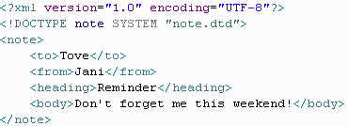

Example of External DTD Declaration
If the DTD is declared in an external file, it should be wrapped in a DOCTYPE definition
Syntax:
<!DOCTYPE root-element SYSTEM "filename“>
note.dtd

Slide 7
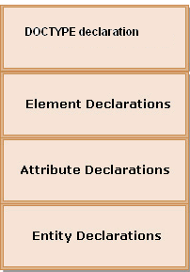
#2.1 - Structure of a DTD
DOCTYPE declaration
  Specifies name of that DTD and either tits content or location
ELEMENT declaration
  Specifies the name of the element, the content which that element can contain
ATTRIBUTE declaration
  Specifies the element that owns the attributes, the attribute name, its type and its default values (if any)
ENTITY declaration
  Specifies the name of the entity and either its value or location of its values.

Slide 8

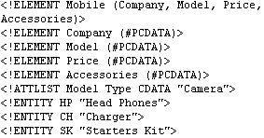
#2.2 - Creating a DTDs step process
Syntax
Declare all the possible elements
Specify the permissible element children if any
Set the order in which element must be appear
Declare all the possible element attributes
Set the attribute data types and values
Declare all the possible entities
Example

Slide 9
Well Formed XML Documents
A "Well Formed" XML document has correct XML syntax.
  XML documents must have a root element
  XML elements must have a closing tag
  XML tags are case sensitive
  XML elements must be properly nested
  XML attribute values must be quoted

Slide 10
Valid XML Documents
A "Valid" XML document is
  A "Well Formed" XML document
  Conforms to the rules of a Document Type Definition (DTD)

Slide 11
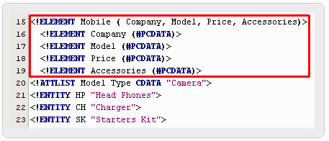
#4.1 - Declaring Elements
<!ELEMENT element–name element–rule>
ELEMENT : keyword
element-name:
  the name of the element
element-rule: one of the
following:
  No Content
  Only PCDATA
  Any Content
  Children
  Only One Occurrence
  Minimum One Occurrence
  Zero or More Occurrence
  Zero or One Occurrence
  Either/Or Content or Mixed Content

Slide 12
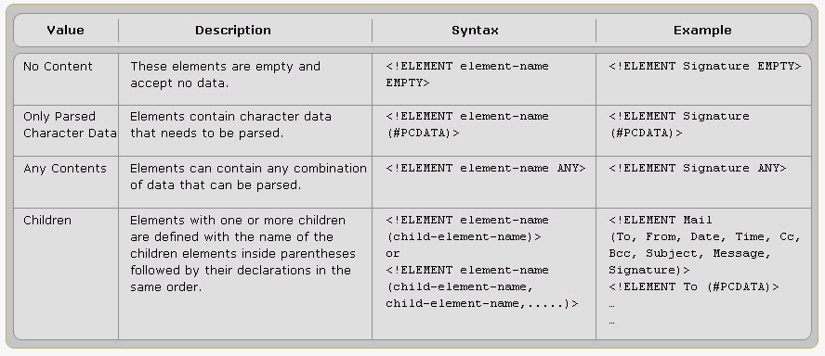
Element Rules

Slide 13
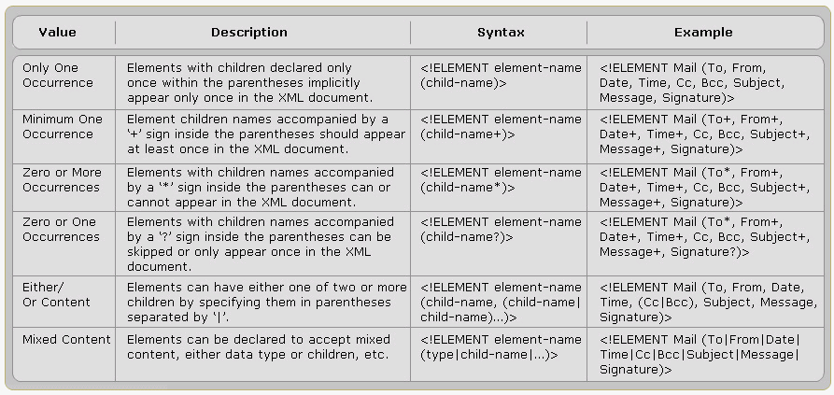
Element Rules contd…

Slide 14
Declaring Mixed Content
An element can have a mixed combination of child elements.
Example:
  <!ELEMENT note (to+, from, header, message*,#PCDATA)>
The sub elements and subgroups can be declared in Sequence or Choice.

Slide 15
Sequence
Element A consists of a single element B.
  <!ELEMENT A (B)>
Element A consists of element B followed by element C
  <!ELEMENT A (B, C)>
Element A consists of a sequence, including a choice subgroup.
  <!ELEMENT A (B, (C | D), E>

Slide 16
Choice
Element A consists of either element B or element C.
  <!ELEMENT A (B | C)>
Element A consists of a choice, including a sequence subgroup.
  <!ELEMENT A (B | C | (D, E))>

Slide 17
#4.2 - Declaring Attributes
<!ATTLIST element-name attribute-name attribute-type default-value>
element-name:
  The element the attribute belong to
attribute-name:
  The name of the attribute
attribute-type:
  Type of data the attribute can accept
default-value:
  Default value for the attribute

Slide 18
attribute-type
Type | Description
CDATA | The value is character data
(en1|en2|..) | The value must be one from an enumerated list
ID | The value is a unique id
IDREF | The value is the id of another element
IDREFS | The value is a list of other ids
NMTOKEN | The value is a valid XML name
NMTOKENS | The value is a list of valid XML names
ENTITY | The value is an entity
ENTITIES | The value is a list of entities
NOTATION | The value is a name of a notation
xml: | The value is a predefined xml value

Slide 19
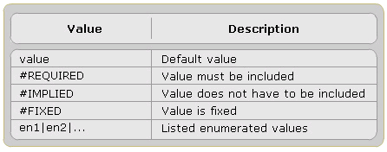
default-value
A Default Attribute Value
  <!ELEMENT square EMPTY>
  <!ATTLIST square width CDATA "0“>
  Valid XML: <square width="100" />

Slide 20
default-value: #REQUIRED
If don't have an option for a default value, but still want to force the attribute to be present.
<!ATTLIST element-name attribute-name attribute-type #REQUIRED>
    DTD: <!ATTLIST person number CDATA #REQUIRED>
    Valid XML: <person number="5677" />
    Invalid XML: <person />

Slide 21
default-value: #IMPLIED
If don't want to force the author to include an attribute, and don't have an option for a default value.
<!ATTLIST element-name attribute-name attribute-type #IMPLIED>
  DTD: <!ATTLIST contact fax CDATA #IMPLIED>
  Valid XML: <contact fax="555-667788" />
  Valid XML: <contact />

Slide 22
default-value: #FIXED
When want an attribute to have a fixed value without allowing the author to change it.
If an author includes another value, the XML parser will return an error.
<!ATTLIST element-name attribute-name attribute-type #FIXED "value">
  DTD: <!ATTLIST sender company CDATA #FIXED "Microsoft">
  Valid XML: <sender company="Microsoft" />
  Invalid XML: <sender company="W3Schools" />

Slide 23
default-value: Enumerated Attribute Values
When want the attribute value to be one of a fixed set of legal values.
<!ATTLIST element-name attribute-name (en1|en2|..) default-value>
  DTD: <!ATTLIST payment type (check|cash) "cash">
  Valid XML:
    <payment type="check" />
    <payment type="cash" />

Slide 24
Structure of a DTD
DOCTYPE declaration
ELEMENT declaration
ATTRIBUTE declaration
ENTITY declaration
<!DOCTYPE root-element SYSTEM "filename“>
<!ELEMENT element–name element–rule>
<!ATLIST element-name attribute-name attribute-type default-value>
<!ENTITY entity-name "entity-value">

Slide 25
That’s all for today!
Document Type Definition
Working with DTD
Valid XML Documents
Declarations
  Doctype
  Element
  Attribute
  Entity
Thank you all for your attention and patient !

